Slide 1
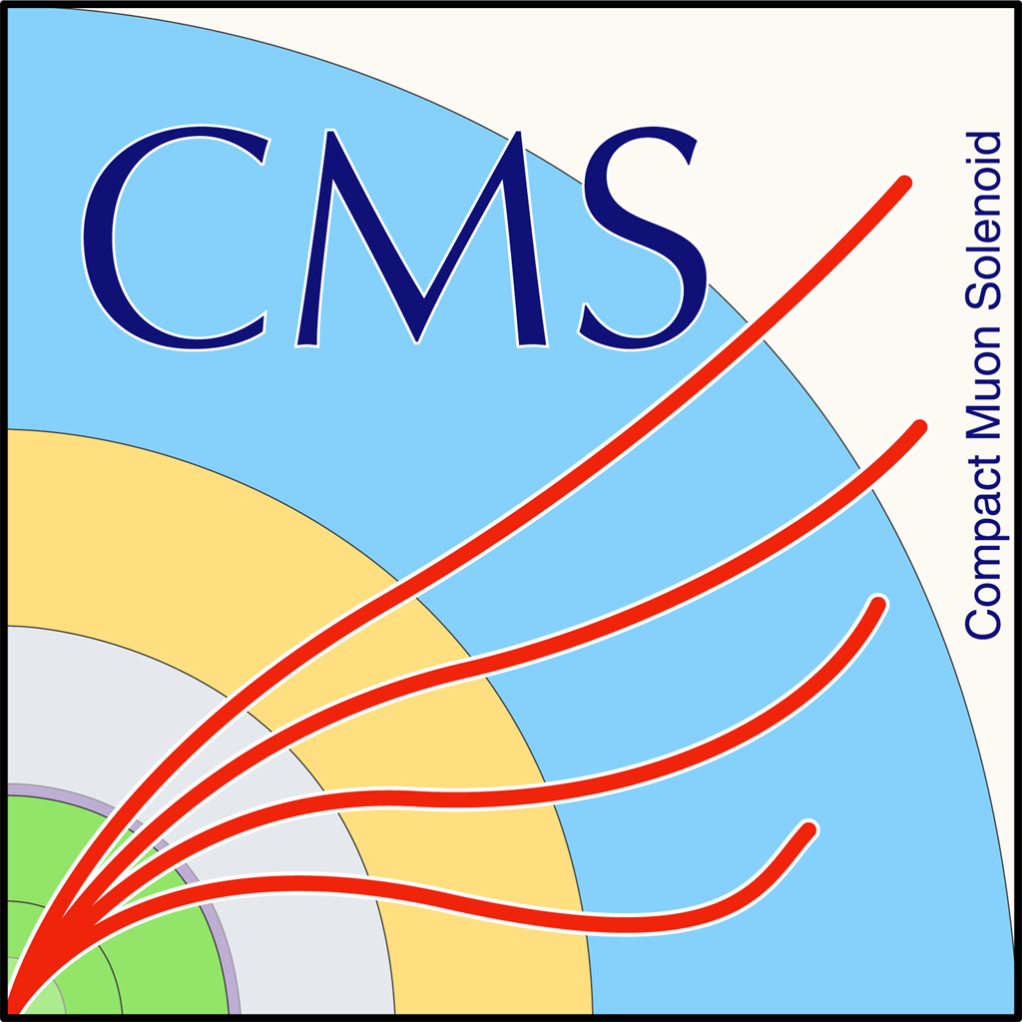

TTbar Differential Cross Section in Fully Hadronic Status Update
G. Bakas
For NTUA

Slide 2
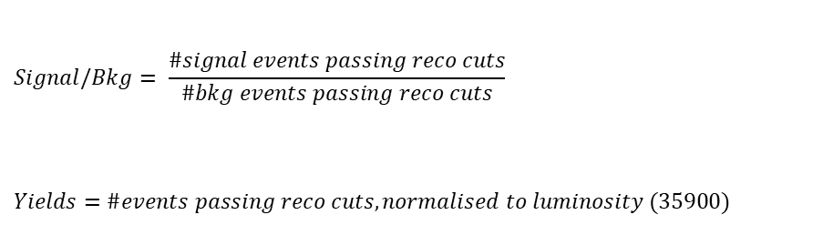
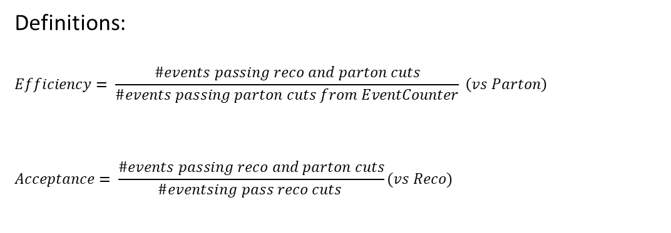
Overview
Efficiencies and Acceptance for mTT and jetPt variables
Selection:
Jet Matching
Parton cuts:
partonPt[0],[1] > 400
|partonEta[0],[1]| < 2.4
mTTbarParton > 1000
Reco cuts:
nJets > 1
nLeptons = 0
mJJ > 1000
jetPt[0],[1] > 400
|jetEta[0],[1]| < 2.4
bTagging (Medium WP deepCSV)
Tagger cut (top Tagger)
JetMassSoftDrop > 120 and < 220
Definitions:
$$Efficiency= \frac{\#events passing reco and parton cuts}{\#events passing parton cuts from EventCounter} \left(vs Parton\right)$$
$$Acceptance= \frac{\#events passing reco and parton cuts}{\#eventsing pass reco cuts }(vs Reco)$$
$$Signal/Bkg= \frac{\#signal events passing reco cuts}{\#bkg events passing reco cuts}$$
$$Yields=\#events passing reco cuts, normalised to luminosity (35900)$$

Slide 3
Purpose of this presentation
Purpose of this presentation is to find a Working Point for each MC (16, 17, 18) because the training is different for each year
Here we use only 1 file
2018 MC’s do not include a 700-1000 File so in order to check consistency of the efficiencies, acceptance etc we use only the 1000-Inf file
2016: We have already decided 0.2 as a WP
2017: The tested working points are 0.0, 0.1, 0.15, 0.18,0.2
2018: The tested working points are 0.0, 0.1, 0.15, ,0.2, 0.25
For each of these WP’s we present the efficiency and acceptance and for the WP’s that seem promising (same efficiency for the pT variable) we show the Signal/Bkg and the expected yields

Slide 4
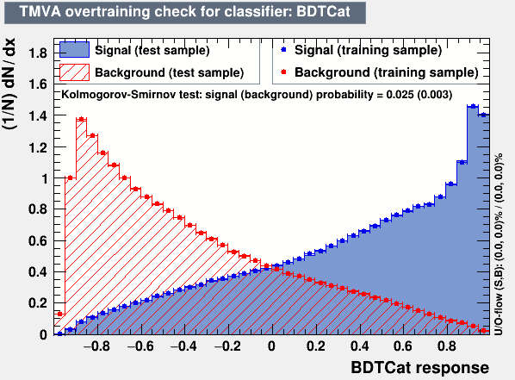
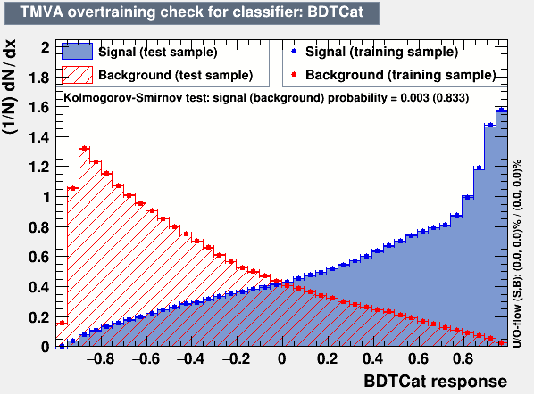
Training Outputs
2017
2018

Slide 5
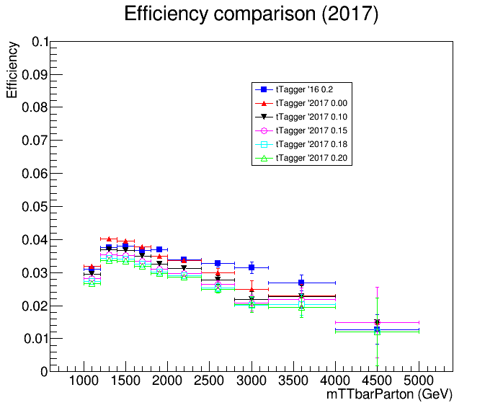
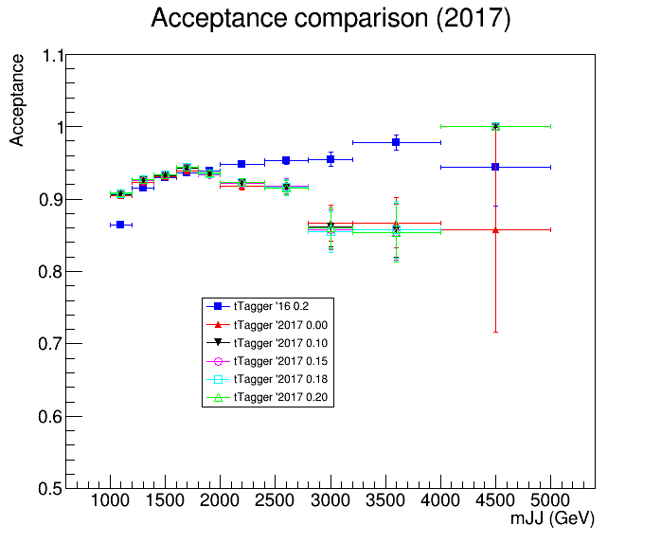
Acceptance and Efficiency 2016 vs 2017

Slide 6
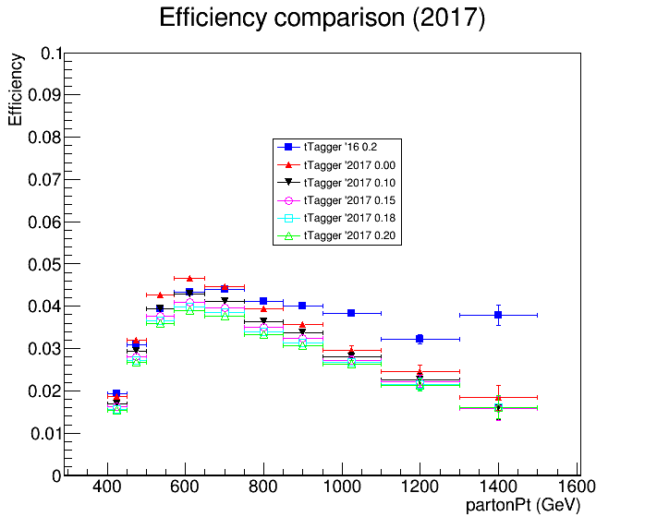
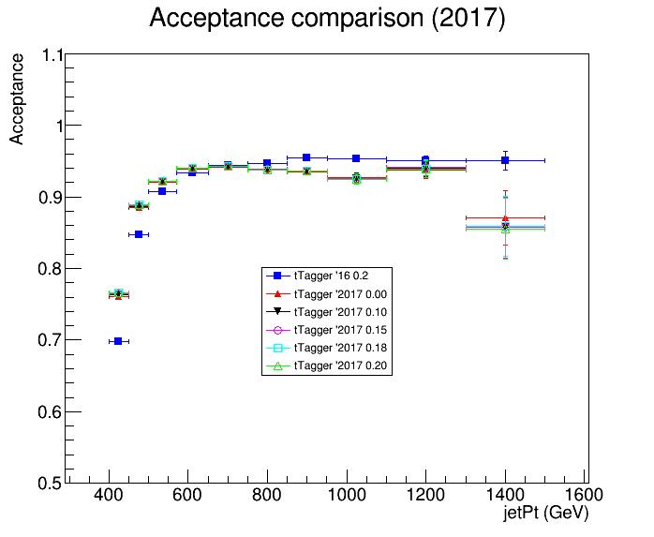
Acceptance and Efficiency 2016 vs 2017

Slide 7
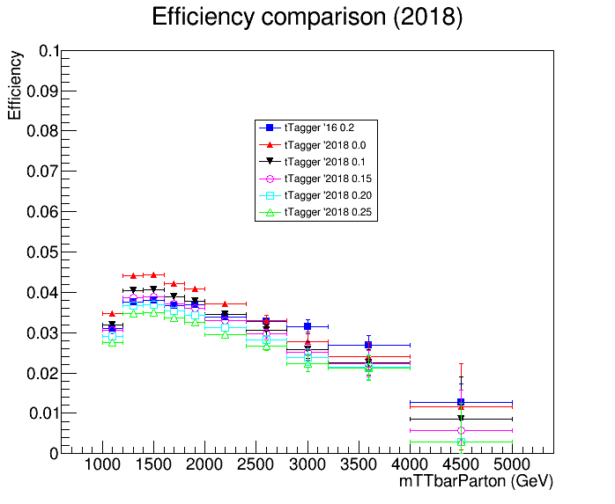
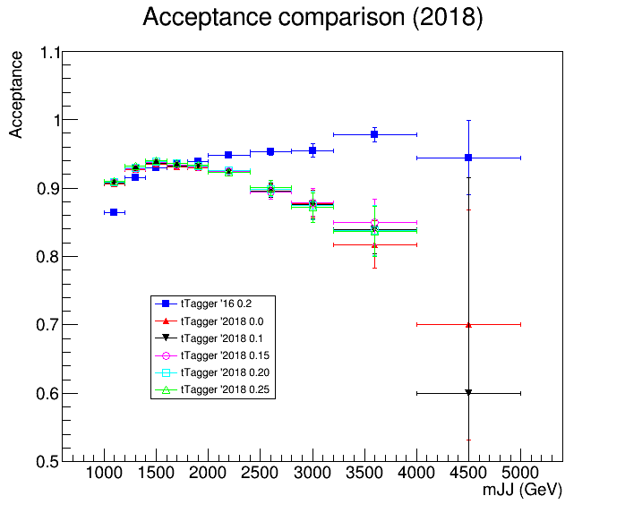
Acceptance and Efficiency 2016 vs 2018

Slide 8
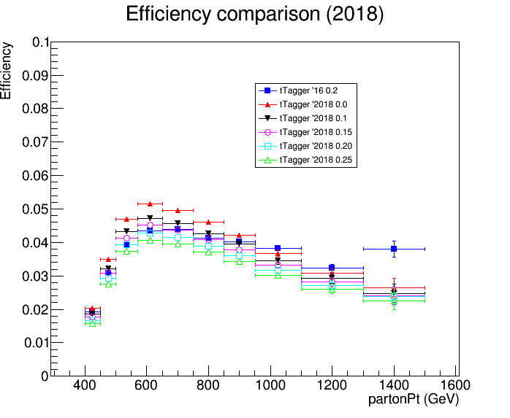
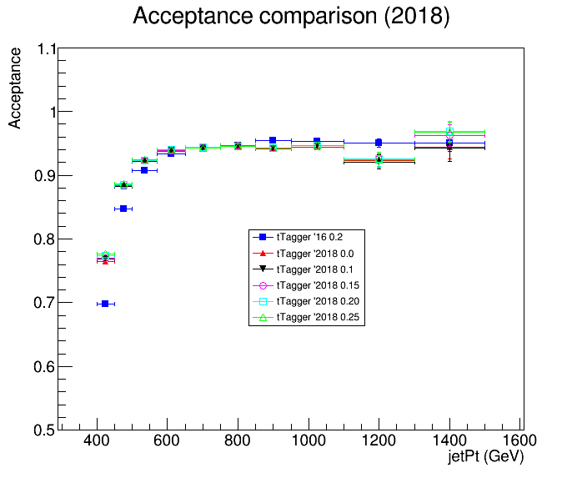
Acceptance and Efficiency 2016 vs 2018

Slide 9
Output
Most promising Working points that are compatible with the 2016 efficiency are the following:
2017: 0.0 and 0.1
2018: 0.1 and 0.15
For these WP’s we also plot the Signal/Bkg wrt the 2016 (0.2 WP)

Slide 10
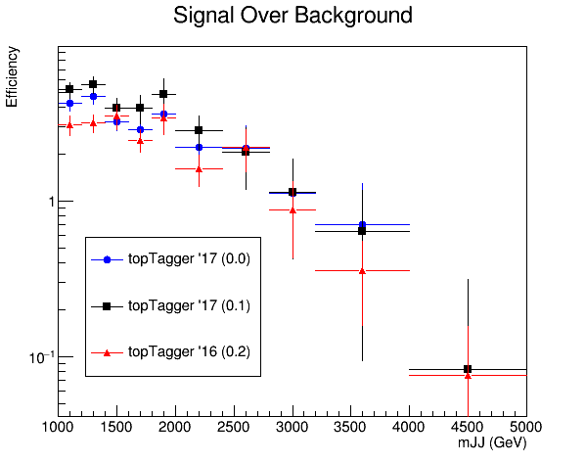
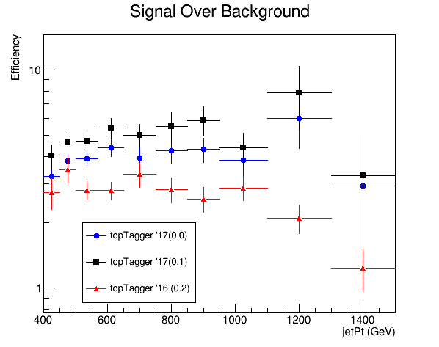
Signal over Background 2016 vs 2017

Slide 11
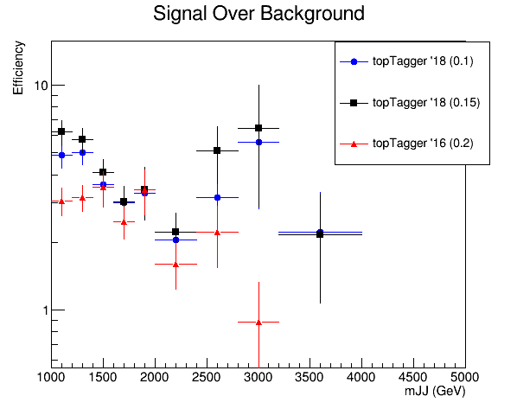
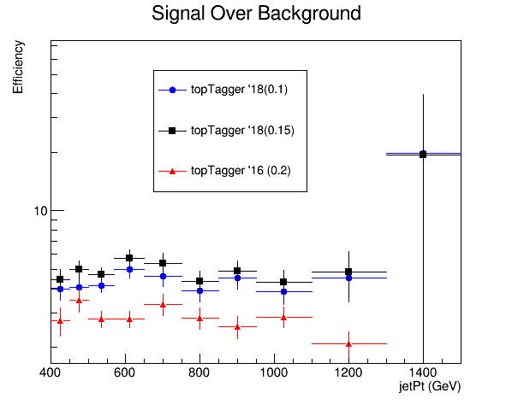
Signal over Background 2016 vs 2018

Slide 12
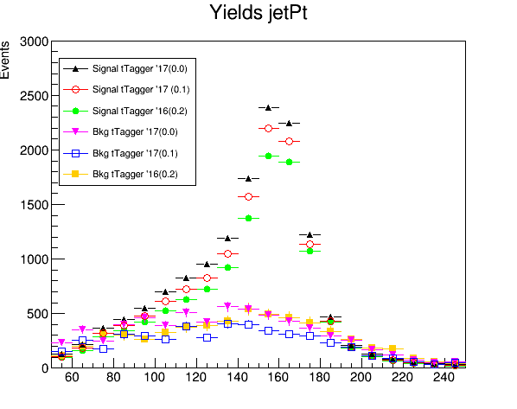
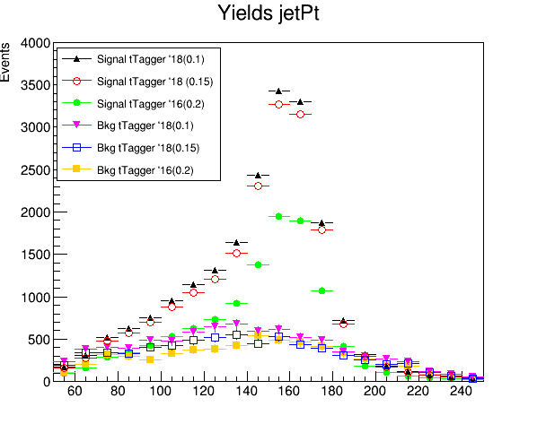
Yields 2016, 2017, 2018
jetMassSoftDrop (GeV)
jetMassSoftDrop (GeV)

